Slide 1
Reinforcement –Power BI Sales Data – Online shop
NAME : MEGASREE M
COURSE : Data Analytics and Data Science
DATE : 11-05-2025

Slide 2
About Dataset
This is a sales transaction data set of UK-based e-commerce (online retail) for one year. This London-based shop has been selling gifts and homewares for adults and children through the website since 2007.
The data set contains 500K rows and 8 columns. The following is the description of each column.
TransactionNo (categorical): a six-digit unique number that defines each transaction. The letter “C” in the code indicates a cancellation.
Date (numeric): the date when each transaction was generated.
ProductNo (categorical): a five or six-digit unique character used to identify a specific product.
Product (categorical): product/item name.
Price (numeric): the price of each product per unit in pound sterling (£).
Quantity (numeric): the quantity of each product per transaction. Negative values related to cancelled transactions.
CustomerNo (categorical): a five-digit unique number that defines each customer.
Country (categorical): name of the country where the customer resides.

Slide 3
Data Cleaning & Transformation
Using Power Query Editor, clean the selected dataset by:
Handling missing values.
Removing duplicates or irrelevant data.
Standardizing data types and formats.
Performing necessary transformations (e.g., splitting columns, merging data, etc.).

Slide 4
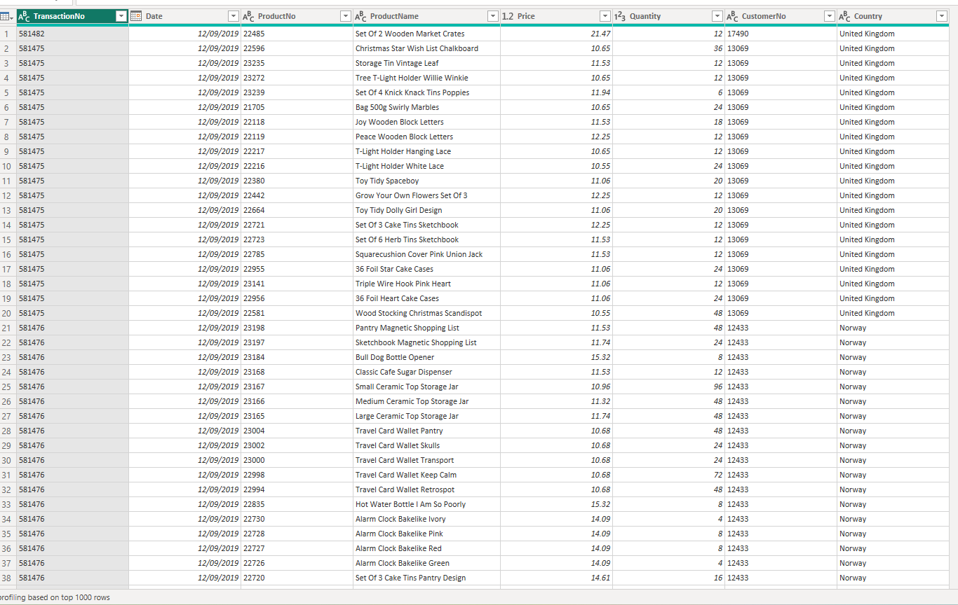

Slide 5
DAX Functions
Total Sales = SUM('Sales Transaction (2)'[Amount])
COUNTROWS = COUNTROWS('Sales Transaction (2)')
Unique Product = DISTINCTCOUNT('Sales Transaction (2)'[ProductNo])
Most sale Month = MAX('Sales Transaction (2)'[Month])
YTD Sales = CALCULATE(SUM('Sales Transaction (2)'[Amount]) , DATESYTD('Sales Transaction (2)'[Date]))
Average sales = AVERAGE('Sales Transaction (2)'[Amount])
AVERAGEX = AVERAGEX(FILTER('Sales Transaction (2)','Sales Transaction (2)'[ProductName]="Blue Pot Plant Candle"),'Sales Transaction (2)'[Amount])
Unique Product name = DISTINCTCOUNT('Sales Transaction (2)'[ProductName])
day most sale = MAX('Sales Transaction (2)'[Day])
Least ProductName = MIN('Sales Transaction (2)'[ProductName])

Slide 6
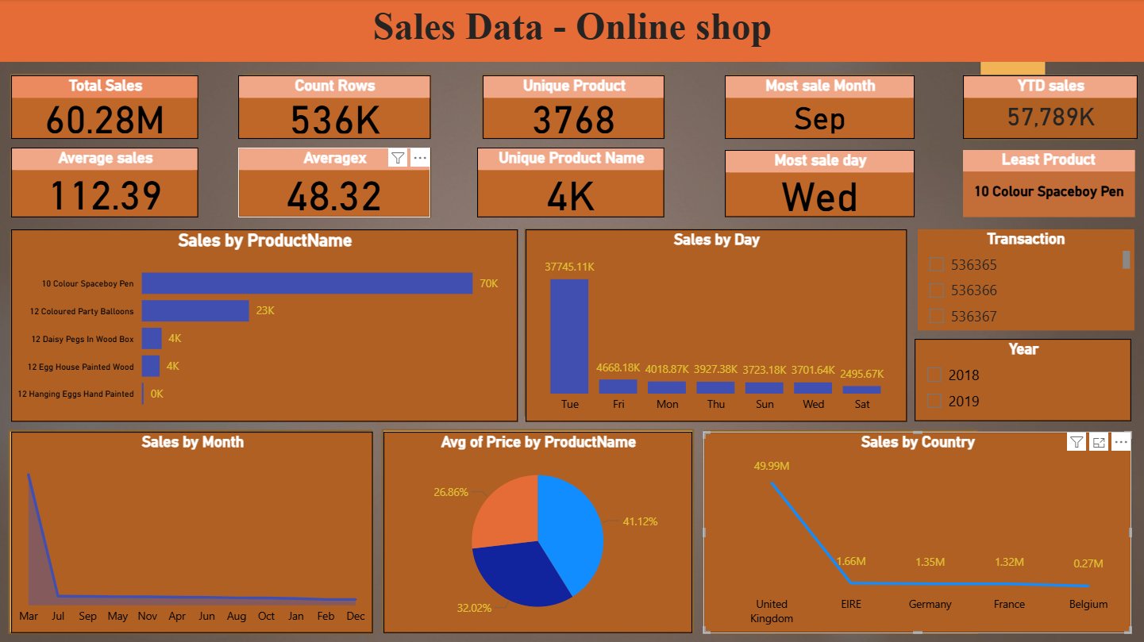
Dashboard Overview

Slide 7
Key Insights
Overall Performance
Total Sales: 60.28M — indicating strong revenue performance.
Total Transactions (Count Rows): 536K — substantial customer engagement.
Sales by Time Top Sales Month: September — peak in seasonal or promotional sales.
Top Sales Day: Wednesday — midweek performs best.
Top Sales Day (by value): Tuesday has the highest sales value (37.7K), which may indicate high-value orders.
Geographical Insights Top Country: United Kingdom (49.99M) — dominant market.

Slide 8
📈 Recommendations
Product Strategy
Promote High Performers: Boost visibility and inventory for 10 Colour Space boy Pen and 12 Coloured Party Balloons.
Marketing & SalesCapitalize on Peak Times: Leverage Wednesday (and Tuesday for value) and September for key campaigns, promotions, and launches.
Customer Segmentation Utilize transaction and average sales data to identify and segment high-value customers for loyalty programs or upselling.

Slide 9
Conclusion
The online shop is heavily reliant on UK customers, with Tuesday being the peak sales day and September the best-performing month.
The 10 Colour Space boy Pen dominates product sales.
There may be a data labeling issue that needs reviewing ("Least Product" contradiction). To grow, expanding into international markets and analyzing underperforming products could be beneficial.

Slide 10
Thank you

